Slide 1
Analysis of Hospital Data

Slide 2
GrOUP E Jie, Parker, Sunitha
Using Census Data API and Hospital CSV data.

Slide 3
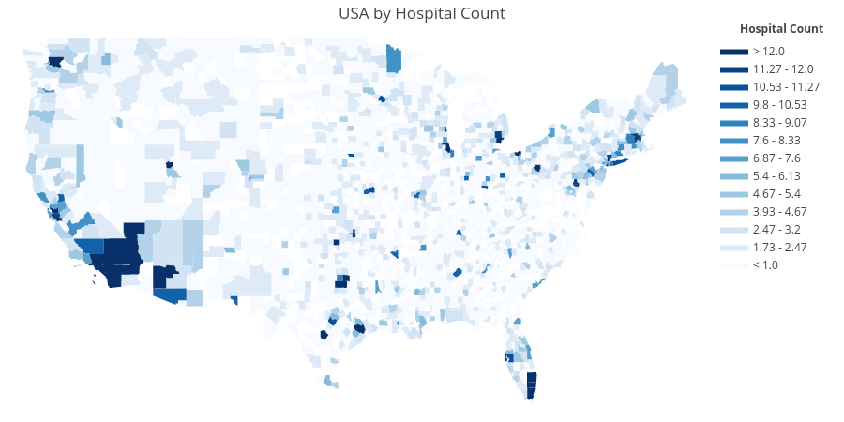
https://plot.ly/~jfdatabc/0

Slide 4
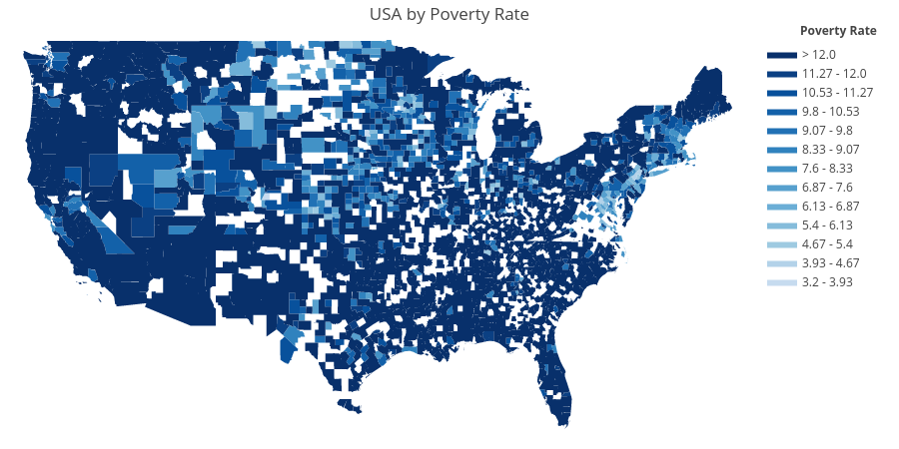
https://plot.ly/~jfdatabc/4

Slide 5
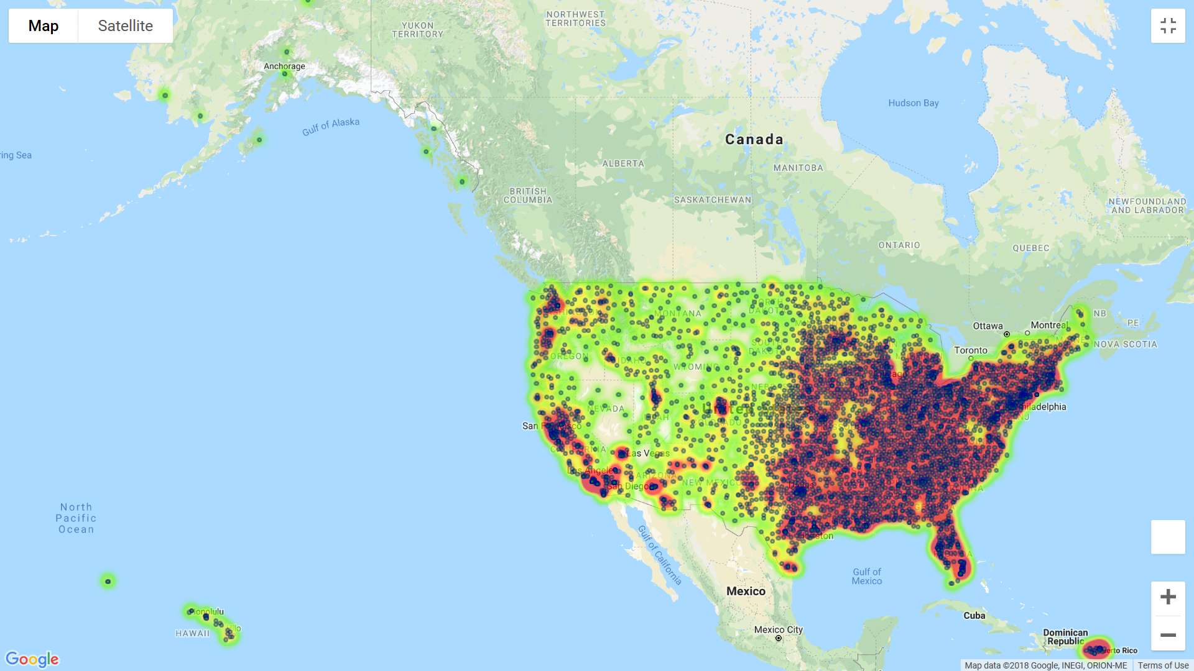
Poverty Rate vs Hospital Count Desert Map

Slide 6
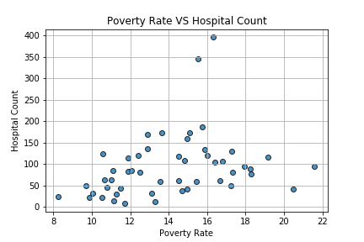

Slide 7
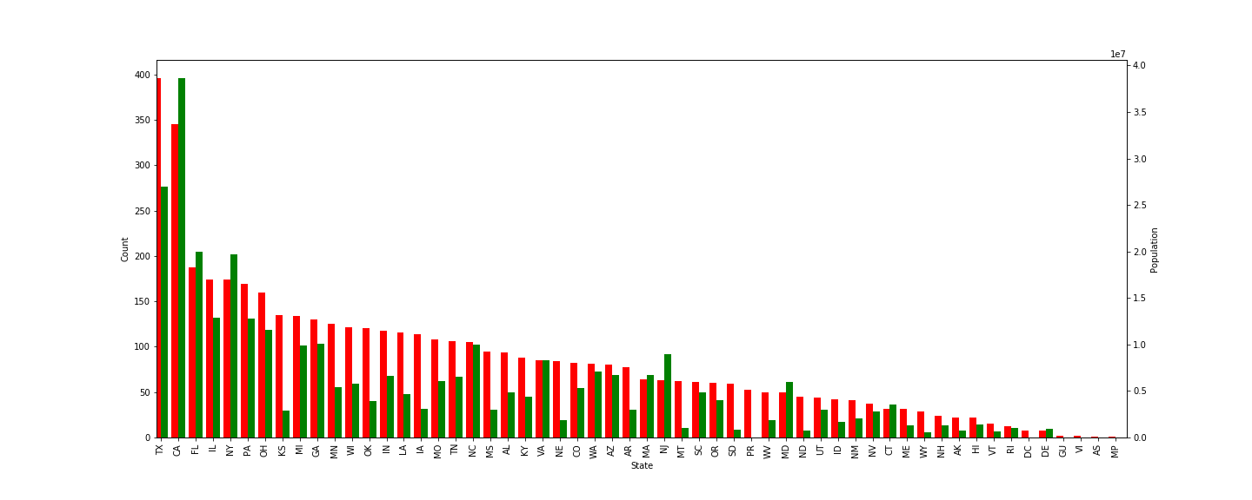
Question: Was there a correlation between population and number of hospitals?

Slide 8
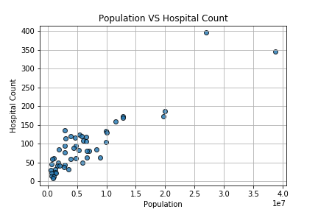
Scatter Plot Shows Correlation between population and hospital Count

Slide 9
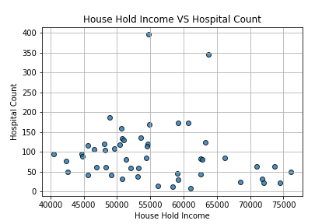
Question: Was there a correlation between house hold income and the number of hospitals?

Slide 10
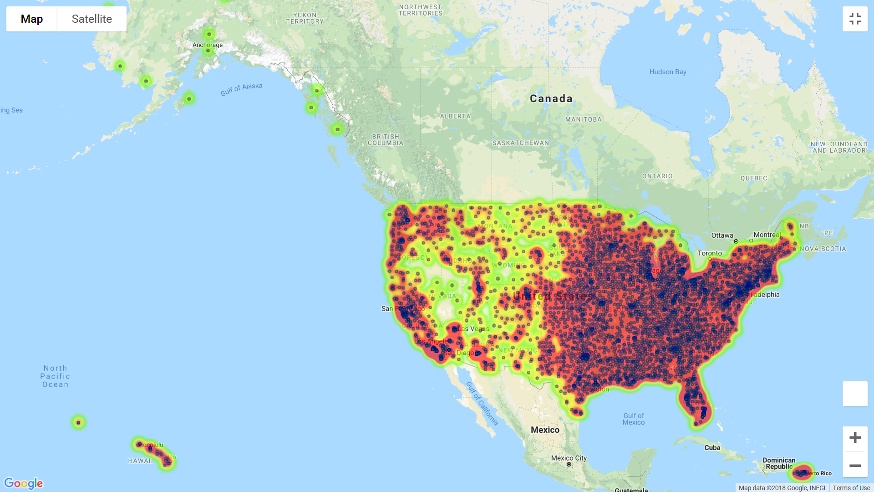
Median Age vs Hospital Count Desert Map

Slide 11
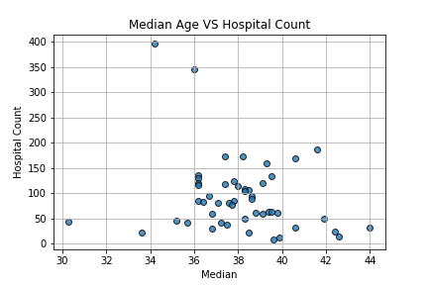

Slide 12
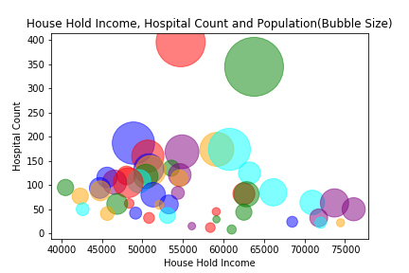

Slide 13
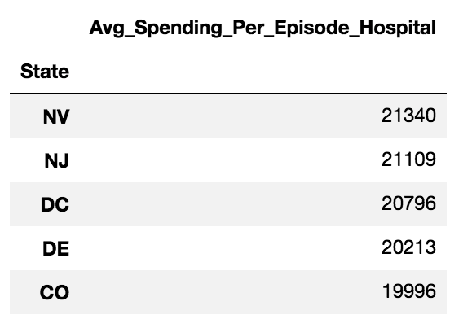
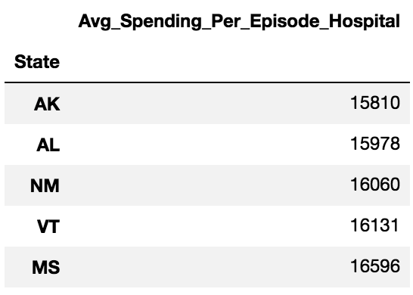
Top 5 Most Expensive States
Top 5 Lease Expensive States

Slide 14
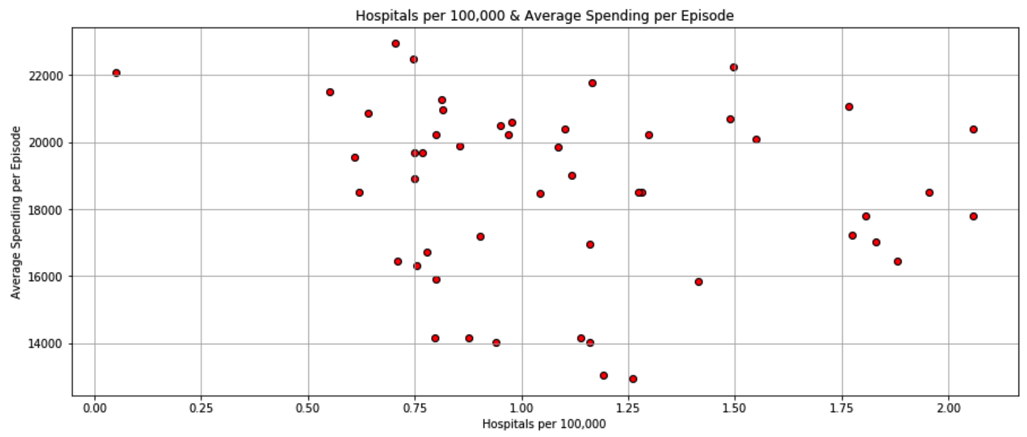

Slide 15
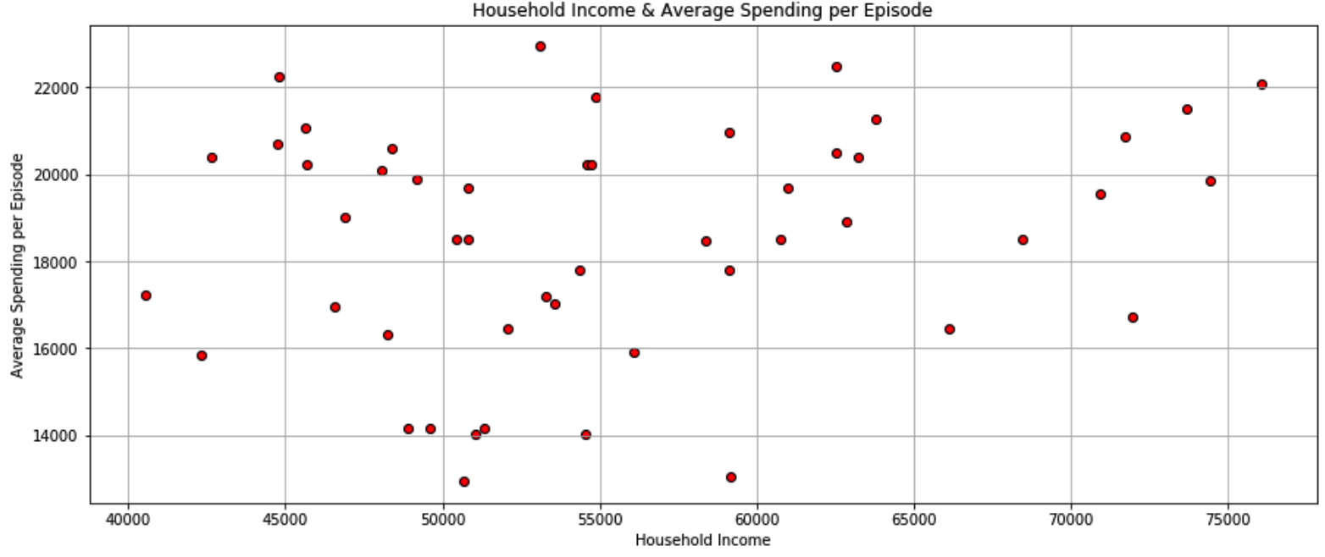

Slide 16
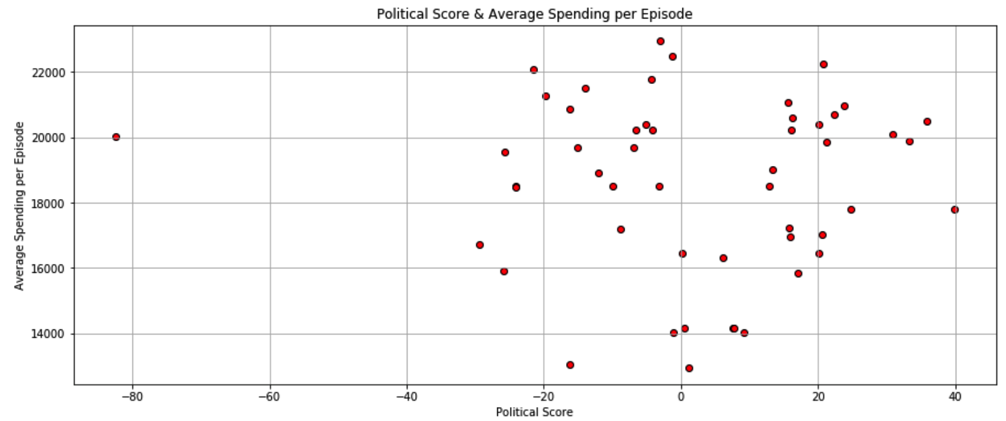

Slide 17
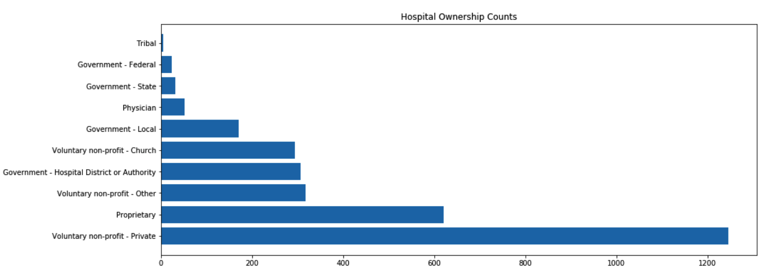

Slide 18
